Slide 1

Introduction to Pandas 🐼
A comprehensive guide to Python's powerful data manipulation and analysis library

Slide 2




What is Pandas?
Python Library
Structured Data
Excel + SQL in Python
A powerful open-source data analysis and manipulation tool built on NumPy
Works seamlessly with tabular data from CSV, Excel, SQL databases and more
Combines the flexibility of spreadsheets with the power of database queries

Slide 3

Why Use Pandas?
Easy Data Handling
Simple functions to load and save data from various sources
Powerful Cleaning & Filtering
Robust tools for data preparation and transformation
Industry Standard
Used extensively in Data Science, AI, and Business Analytics
Time Efficient
Accomplishes in a few lines what would take many in plain Python

Slide 4

Pandas Data Structures
Series (1D)
DataFrame (2D)
One-dimensional labeled array, similar to a column in Excel
Two-dimensional table with rows and columns, like an Excel spreadsheet or SQL table
Math 85Science 90English 78dtype: int64
Name Age Marks0 Alice 24 851 Bob 27 90
Each value has a label (index) and can be accessed by position or label
Multiple columns with row indices, allowing for complex data operations

Slide 5




Basic Pandas Operations
Read
Filter & Sort
Load data from CSV, Excel, SQL, and other formats
Select specific rows and order data
pd.read_csv('data.csv')
df[df['Age'] > 25].sort_values('Marks')
Analyze
Write
Calculate statistics and summaries
Save processed data to files
df.describe()
df.to_csv('output.csv')
These fundamental operations form the building blocks for more complex data analysis workflows.

Slide 6

Real-World Use Cases
HR Analytics
Analyzing employee salaries, department distributions, and performance metrics
Education
Teachers tracking student performance, attendance patterns, and identifying areas for improvement
Business Intelligence
Analyzing sales trends, customer behavior, and inventory management
Data Science
Cleaning and preparing datasets for machine learning models and statistical analysis

Slide 7
Demo Flow
01
02
03
Series Creation & Manipulation
DataFrame Construction
Data Import & Export
Creating one-dimensional data structures and performing basic operations
Building two-dimensional tables from scratch and from existing data
Reading from and writing to various file formats (CSV, Excel, etc.)
04
05
Data Transformation
Statistical Analysis
Filtering, sorting, and reshaping data to extract insights
Using built-in methods to calculate descriptive statistics

Slide 8

Hands-On Tasks
Create a Series
Build a Series of daily sales data for Monday through Sunday
1
sales = pd.Series([120, 85, 140, 130, 190, 210, 95], index=['Mon', 'Tue', 'Wed', 'Thu', 'Fri', 'Sat', 'Sun'])
Build a DataFrame
2
Create a DataFrame of employees with Name, Department, and Salary columns
Work with CSV Data
3
Filter students older than 25, sort by marks in descending order, and save results
Calculate Statistics
4
Use .describe() to get averages and other summary statistics

Slide 9

Mini Project – Movie Database
Create a Movie Dataset
Tasks to Complete:
Build a DataFrame with these columns:
Filter Recent Films
Find Top Rated
Title
Find all movies released after 2010
Identify the highest rated movie in the database
Director
Year
recent_movies = movies[movies['Year'] > 2010]
top_movie = movies.loc[movies['Rating'].idxmax()]
Rating
Group by Director
Analyze movies grouped by director to find patterns
director_stats = movies.groupby('Director').agg({'Rating': 'mean'})

Slide 10

Key Takeaways
Pandas = Excel + SQL in Python
Core Concepts
Next Steps
Series (1D): One-dimensional labeled arrays
Practice with real CSV files from your domain
DataFrame (2D): Two-dimensional tables with rows and columns
Explore more advanced functions like groupby and pivot
Operations: Read, Write, Filter, Sort, Describe
Combine with visualization libraries like Matplotlib

Slide 11
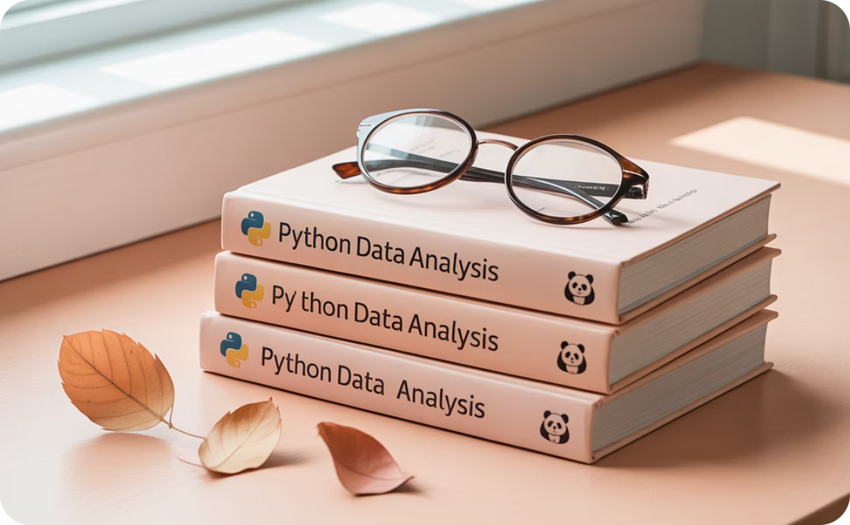


Practice Resources
Official Documentation
Video Tutorials
Practice Datasets
Comprehensive guides and API reference at pandas.pydata.org
Step-by-step visual guides on platforms like YouTube and Coursera
Real-world datasets from Kaggle and other data repositories
The best way to learn Pandas is through consistent practice with real data that interests you!

Slide 12

Thank You!
Any Questions?
Contact Information
Feel free to reach out if you have any questions about today's session or need help with your pandas projects.
Remember: The pandas community is very active and supportive. Stack Overflow and GitHub are excellent resources when you encounter challenges.

